Slide 1

Accelerating Distributed Machine Learning by Smart Parameter Server
Jinkun Geng, Dan Li and Shuai Wang
Notes:
Hello, everyone. I am Jinkun Geng from Tsinghua University. Today the topic I would like to share with you is “accelerating distributed machine…”, this work was cooperated with my supervisor Professor Dan Li, and Mr. Shuai Wang.

Slide 2
Background
Distributed machine learning becomes the common practice, because of:
1. The explosive growth of data size
Notes:
As we all know, machine learning has become the hottest topic in every field, and distributed machine learning has become the common practice. On one hand, the training data is experiencing an explosive growth,

Slide 3
Background
Distributed machine learning becomes the common practice, because of:
2. The increasing complexity of training model
ImageNet Competition:
<10(Hinton, 2012),
22 (Google, 2014),
152 (Microsoft, 2015), 1207 (SenseTime, 2016)
Notes:
And on the other hand, the training model is also becoming more and more complex, in order to gain stronger learning capability.

Slide 4
Background
Parameter Server (PS)-based architecture is widely supported by mainstream DML systems.
Notes:
Both the increasing size of training data and training model motivate the development of DML systems. And parameter server system has is widely supported by the mainstream DML systems, such as Tensorflow, MXNEt, Pytorch and so on.

Slide 5

Background
However, the power of PS architecture has not been fully exploited.
1. Communication redundancy
2. Straggler problem
Notes:
However, the power of PS architecture has not been fully exploited. The first issue is the communication redundancy. During the iterative DML process, there is much communication redundancy involved. The second issue is the straggler problem. As mentioned in the talk of yesterday, when we use BSP for DML, the overall performance actually is determined by the slowest worker, that is, the straggler.

Slide 6


Background
A deeper insight…
1. Worker-centric design is less efficient
2. PS can be more intelligent (i.e. Smart PS)
Smart PS
Notes:
So how can we try to optimize the DML performance and mitigate the two problems? With a deep insight into the current PS-based arch, we note that the existing works all follows the worker-centric design, which can be less efficient. Actually, the parameter server can usually hold more information than the worker, which can be better exploited. In other words, PS can hold a global view of the parameter dependencies whereas workers only hold a partical view of itself. Therefore, we can make the PS more intelligent and design a smart PS.

Slide 7
Background
To make PS more intelligent…
Dependency-Aware
Straggler-Assistant
Notes:
Targeting at the aforementioned two problems, if we want to accelerate DML with a smart PS, then the PS should be dependency-aware, as well as straggler-assistant. I will talk about the two features in the following slides.

Slide 8
A Simple Model of Parameters
Notes:
In order to study the dependency among parameters, we first need to generate a simple model for parameters, because as we know, the current DML models may have millions of, or even billions of parameters, and the cost is unaffordable if we study the dependency among each two of them. Fortunately, reviewing the typical DML models, we can find that a certain group of parameters may have similar behavior during the DML process, and we can just treat them as one unit. For example, in deep neural network, the parameters in one layer share the same behavior, so we partition the parameters in to parameter units (PU) in a layer-wise manner. Another example, is the matrix factorization. Each matrix block can be considered as one unit. The partition of the parameters is user-defined and here we just illustrate them with some typical examples. Users can choose their own way to define the parameter unit.

Slide 9
Workflow of PS-based DML
Notes:
So with the simple model of PU, let’s have a look at the workflow of PS-based DML. Generally speaking, the workflow can be divided into four phases. During the first step, workers pull the parameters from the PS. During the second step, workers compute for parameter refinement. During the third step, they push the refined parameters to the Pses. During the forth step, parameters aggregate the parameters and wait for the worker to pull them back and start the next iteration.

Slide 10
Workflow of PS-based DML
Notes:
If we depict the four phases in timeline, it can be illustrated as this picture. We can see that the makespan of one iteration is composed of four main parts.

Slide 11
Workflow of PS-based DML
Notes:
In our work of SmartPS, we mainy focus on the three parts and try to acclerate DML by optimizing them. As for the remaining tc, there have been a series of existing works, such as work stealing, to optimize them. And these works can be further complimented with SmartPS to further improve the DML performance.

Slide 12
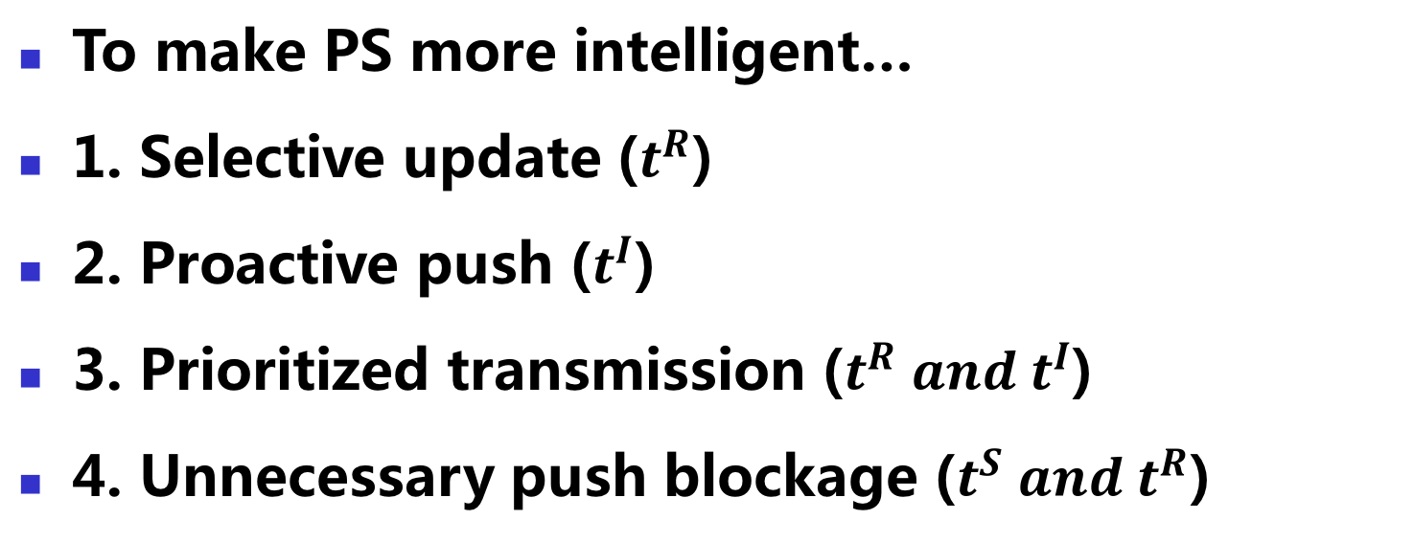
Design Strategies
To make PS more intelligent…
1. Selective update ($t^{R}$)
2. Proactive push ($t^{I}$)
3. Prioritized transmission ($t^{R} and t^{I}$)
4. Unnecessary push blockage ($t^{S} and t^{R}$)
Notes:
In order to accelerate DML with more intelligence in PS, we design four main stategies.
And I will introduce them one by one.

Slide 13
Strategy 1: Selective Update
Notes:
Recall the workflow of DML. We can see for the typical DML tasks, especially those model-parallel tasks, not every worker needs all fresh parameters during one iteration.

Slide 14
Strategy 1: Selective Update
$$PU\left(i,j\right) denotes {PU}_{j} in {Iteration}_{i}$$
Notes:
For example, we suppose there are four workers and each worker holds just one PU. The dependency among PUs can be illustrated in this picture.

Slide 15
Strategy 1: Selective Update
$$PU\left(i,j\right) denotes {PU}_{j} in {Iteration}_{i}$$
Notes:
When we use BSP for DML, the overall performance is mainly determined by the slowest worker, that is worker 3.

Slide 16
Strategy 1: Selective Update
$$PU\left(i,j\right) denotes {PU}_{j} in {Iteration}_{i}$$
Notes:
But we can see that, during the two iterations, the PU on worker 0 does not depend on the PUs from worker 3, so it does not need to pull the parameters from worker 3. Instead, it just need to selectively pull the parameters from worker 1 to update its local parameters. So the transmission time is saved.

Slide 17
Strategy 2: Proactive Push
$$PU\left(i,j\right) denotes {PU}_{j} in {Iteration}_{i}$$
Notes:
Meanwhile, though worker 0 does not depend on worker 3, but worker 3 depends on worker 0. Remember that worker 3 is the slowest whereas worker 0 is the fastest. So even worker 3 is still computing and has not asked for the parameters, worker 0 has prepared the parameters and pushed it to the PS. So PS can proactively push the parameters to worker 3 even before it asked for that. In this way, the parameters do not need to remain idle on the PS and they can be accessed by the worker at an earlier time.

Slide 18
Strategy 3: Straggler-Assistant
$$PU\left(i,j\right) denotes {PU}_{j} in {Iteration}_{i}$$
Notes:
As for the third strategy, we try to assist the stragglers by prioritized parameters transmission. Take the data-parallel DML tasks as an example, the PUs on each worker is needed by the PUs of all the others.

Slide 19
Strategy 3: Straggler-Assistant
$$Baseline (No Assistance):$$
Notes:
We assume that worker 0 is the slowest, whereas worker 2 is the fasters. Then worker 0 becomes the straggler. If we treat them as the same. Then when the parameters are available on the PS, the PS will transmit the parameters to each worker equally. That is to say, they will share the bandwidth, and will access the parameters at the same time.

Slide 20
Strategy 3: Straggler-Assistant
$$Straggler−Assistant:$$
Notes:
However, if we first transmit the parameters to worker 0, then to worker 1, and finally to worker 2, then worker 0 can access the parameters earlier and start the next iteration earlier. In this way, the performance gap between worker 0 and worker 1 is narrowed in the following iterations, and the overall training performance can be accelerated.

Slide 21
Strategy 4: Blocking Unnecessary Pushes
$$Straggler Assistant Transmission:$$
Notes:
And as for the last strategy, we try to utilize the data locality of DML tasks. For example, we can see that for worker 2, the PU on its server is not needed by the others during the two iterations, therefore, after the first iteration, it does not need to push the parameters to the PS. In other words, we just block the unnecessary pushes and the save the tranismission bandwidth and time.

Slide 22
Evaluation
Experiment Setting：
17 Nodes with different performance configurations: 1 PS + 16 Worker
2 Benchmarks:
Matrix Factorization and PageRank
5 Baselines：
BSP， ASP，SSP（slack=1）， SSP（slack =2），SSP （slack =3）
Notes:
Okay, so with the four intelligent strategies integrated, we conduct comparative experiments to evaluate the SmartPS.

Slide 23
Evaluation
MF Benchmark:
With a common threshold, SmartPS reduces the training time by 68.1%~90.3% compared with the baselines.

Slide 24
Evaluation
PR Benchmark:
With a common threshold, SmartPS reduces the training time by 65.7%~84.9% compared with the baselines.

Slide 25
Further Discussion
Comparison to some recent works:
SmartPS | TICTAC/P3
Both leverage the knowledge of parameter dependency
2. Both leverage prioritized transmission
for DML acceleration

Slide 26
Further Discussion
Comparison to some recent works:
SmartPS | TICTAC/P3
General Solution (Data-Parallel and Model-Parallel) | CNN-Specific
Straggler-Assistant | Straggler-Oblivious
Inter- and Intra-Iteration Overlap | Only Inter-Iteration Overlap
Compatible to ASP and SSP | Only work for BSP (worsen the performance gap under ASP)

Slide 27
Ongoing Work
A deeper insight into PS-based arch…
Function of PS:
1. Parameter Distribution
2. Parameter Aggregation
Function of Worker:
1. Parameter Refinement
-> Data Access Control
-> Data Operation
-> Data Operation

Slide 28
Ongoing Work
Parameter Distribution
Parameter Aggregation
Parameter Refinement

Slide 29
Ongoing Work
Data Access Control
Data Operation
Data Operation

Slide 30
Ongoing Work
Data Access Control
Token
Token
Token
Data Operation

Slide 31
Next Generation of SmartPS
Parameter Server -> Token Server
1. Decouple data (access) control and data operation
2. A light-weight and smart Token Server instead of Parameter Server.
Token Server
Parameter Server

Slide 32

Thanks!
NASP Research Group
https://nasp.cs.tsinghua.edu.cn/
https://www.gengjinkun.com/

